Slide 1
Text Classification and Naïve Bayes
The Task of Text Classification

Slide 2
Is this spam?

Slide 3
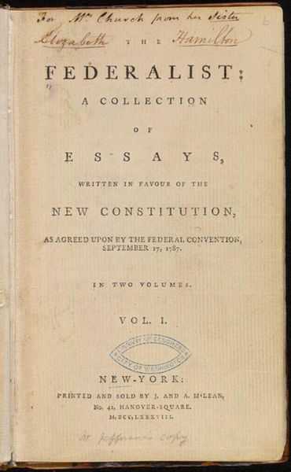
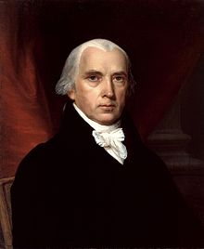
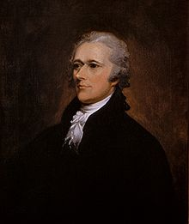
Who wrote which Federalist papers?
1787-8: anonymous essays try to convince New York to ratify U.S Constitution: Jay, Madison, Hamilton.
Authorship of 12 of the letters in dispute
1963: solved by Mosteller and Wallace using Bayesian methods
James Madison
Alexander Hamilton

Slide 4
Male or female author?
By 1925 present-day Vietnam was divided into three parts under French colonial rule. The southern region embracing Saigon and the Mekong delta was the colony of Cochin-China; the central area with its imperial capital at Hue was the protectorate of Annam…
Clara never failed to be astonished by the extraordinary felicity of her own name. She found it hard to trust herself to the mercy of fate, which had managed over the years to convert her greatest shame into one of her greatest assets…
S. Argamon, M. Koppel, J. Fine, A. R. Shimoni, 2003. “Gender, Genre, and Writing Style in Formal Written Texts,” Text, volume 23, number 3, pp. 321–346
Notes:
#1: Saigon. Grey, Anthony
#2: Jerusalem the Golden. Drabble, Margaret
From shlomo argamon

Slide 5


Positive or negative movie review?
unbelievably disappointing
Full of zany characters and richly applied satire, and some great plot twists
this is the greatest screwball comedy ever filmed
It was pathetic. The worst part about it was the boxing scenes.

Slide 6
What is the subject of this article?
MEDLINE Article
MeSH Subject Category Hierarchy
Antogonists and Inhibitors
Blood Supply
Chemistry
Drug Therapy
Embryology
Epidemiology
…
?

Slide 7
Text Classification
Assigning subject categories, topics, or genres
Spam detection
Authorship identification
Age/gender identification
Language Identification
Sentiment analysis
…

Slide 8
Text Classification: definition
Input:
a document d
a fixed set of classes C = {c₁, c₂,…, c_{J}}
Output: a predicted class c ∈ C

Slide 9
Classification Methods: Hand-coded rules
Rules based on combinations of words or other features
spam: black-list-address OR (“dollars” AND“have been selected”)
Accuracy can be high
If rules carefully refined by expert
But building and maintaining these rules is expensive

Slide 10
Classification Methods: Supervised Machine Learning
Input:
a document d
a fixed set of classes C = {c₁, c₂,…, c_{J}}
A training set of m hand-labeled documents (d₁,c₁),....,(d_{m},c_{m})
Output:
a learned classifier γ:d → c

Slide 11
Classification Methods: Supervised Machine Learning
Any kind of classifier
Naïve Bayes
Logistic regression
Support-vector machines
k-Nearest Neighbors
…

Slide 12
Text Classification and Naïve Bayes
The Task of Text Classification

